Slide 1
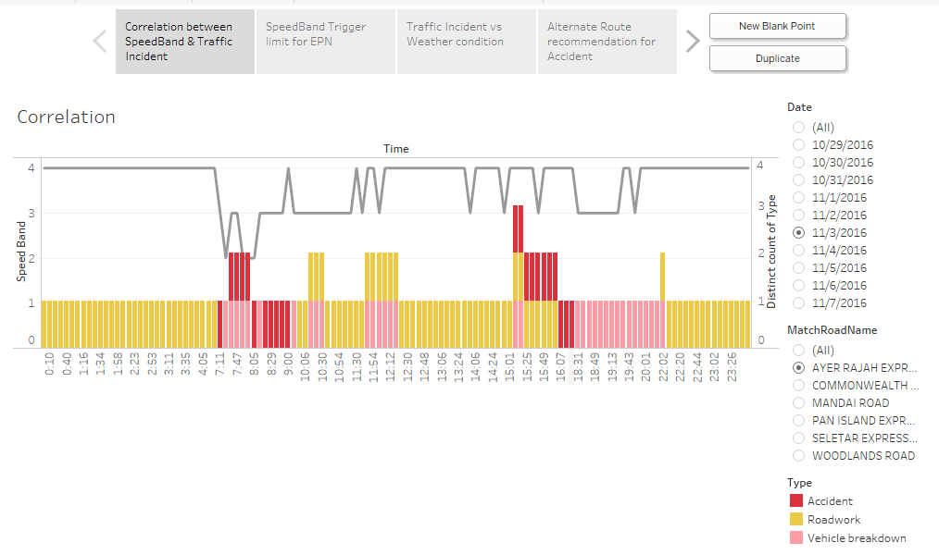
Correlation between Speedband and Traffic Incident

Slide 2
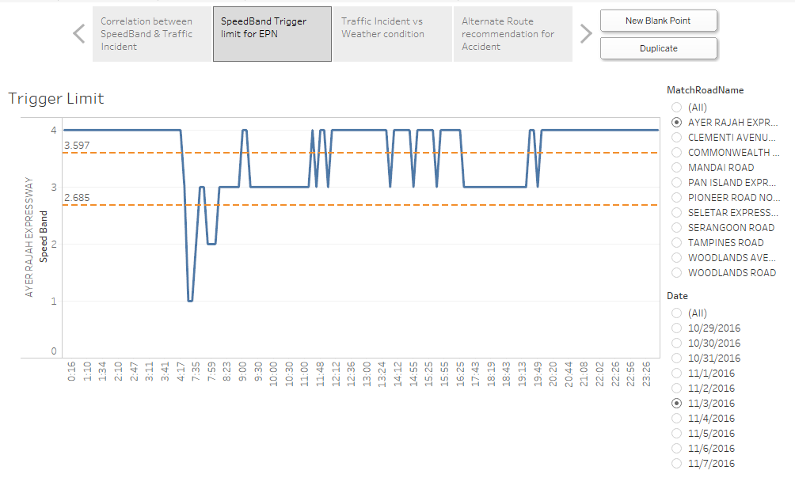
SpeedBand Trigger limit for EPN

Slide 3
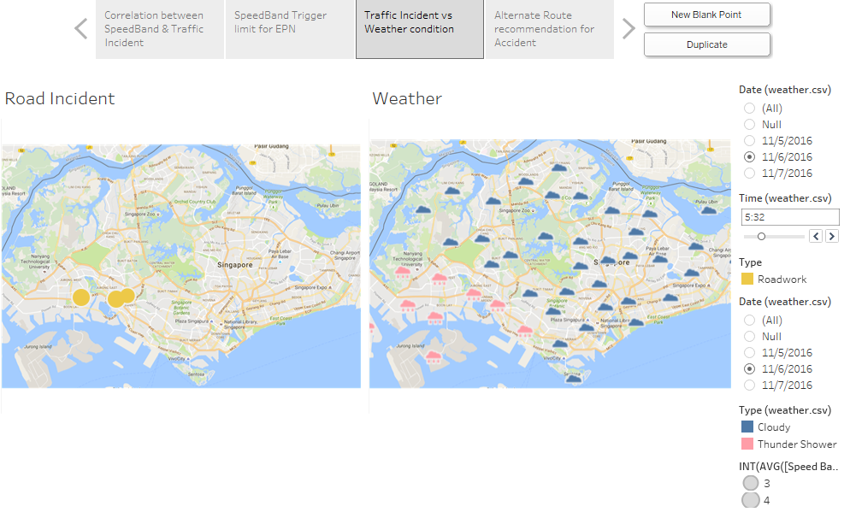
Traffic Condition vs Weather Condition

Slide 4
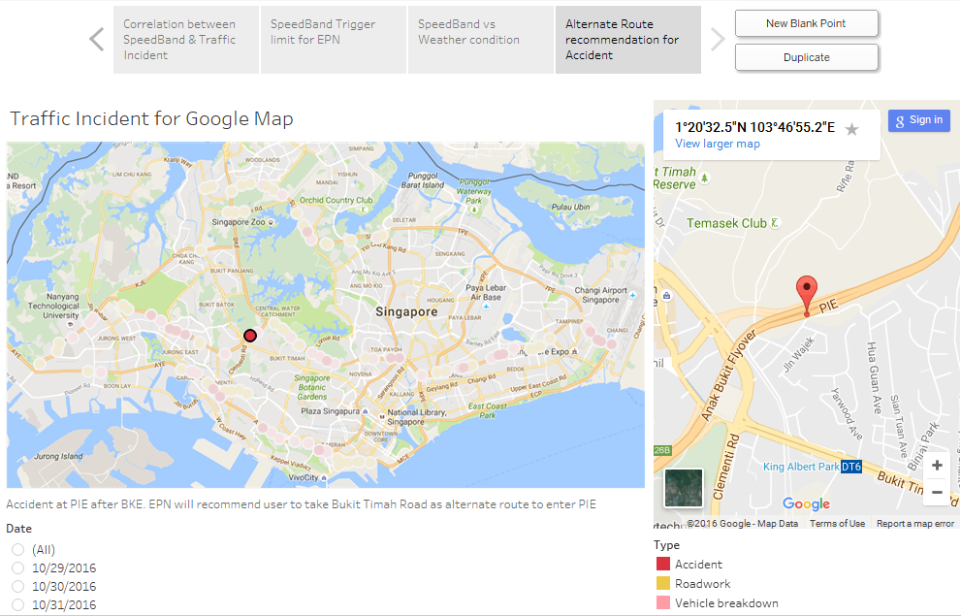
Alternate Route recommender

